Slide 1
Applied Natural Language Processing
Dr. Sucharitha Shetty

Slide 2
Table of Contents
RNN –Recurrent Neural Network

Slide 3
NLP
BOW, TFIDF, Word2Vec-CBoW,SkipGram
Deep Learning :RNN, LSTM RNN, GRU RNN,

Slide 4
RNN
Converting text to vectors
Which is the most efficient way till now-Word2Vec
(Word Embedding, embedding layer)
Now consider, chatbot-ask Q get A
Q is imp and answer A: Here sequence of words is imp
Now consider lang translation –English to Hindi
Sequence of words is imp, even grammar

Slide 5
RNN
Consider Sentiment Analysis
Consider Text Generation: in gmail,linkedin, how to complete sentence .. Grammatically will be very good…auto-suggestion
All these models, sequence of words, grammatically should be right.
ML not reliable needed on day-to-day basis.
Deep learning – was earlier used by Google..b4 transformers
Notes:
Word2vec is a technique..to convert word to vectors it catches semantic meanings

Slide 6
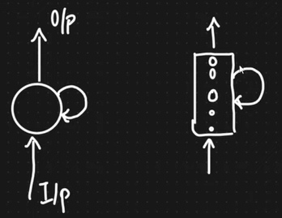
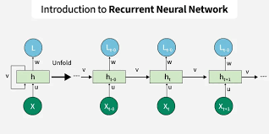
RNN

Slide 7
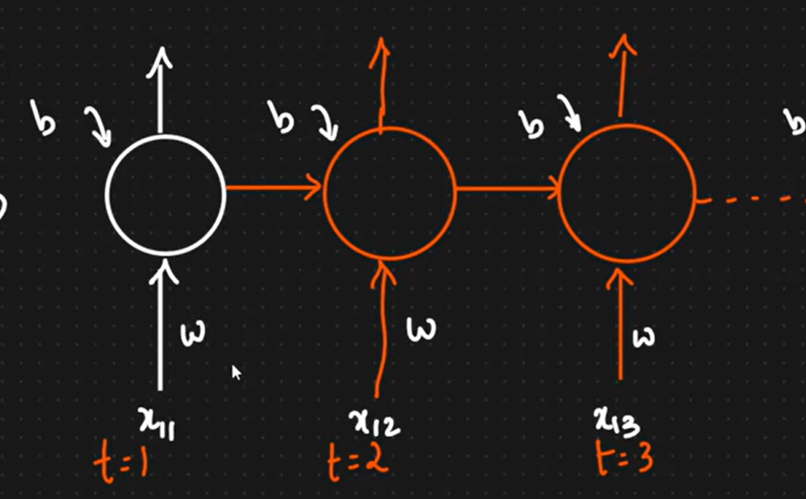
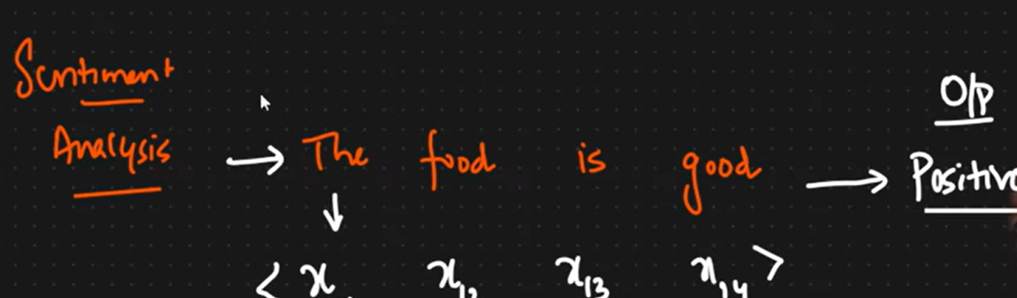
RNN
Sentiment Analysis :
Eg: The food is good – O/p is positive

Slide 8
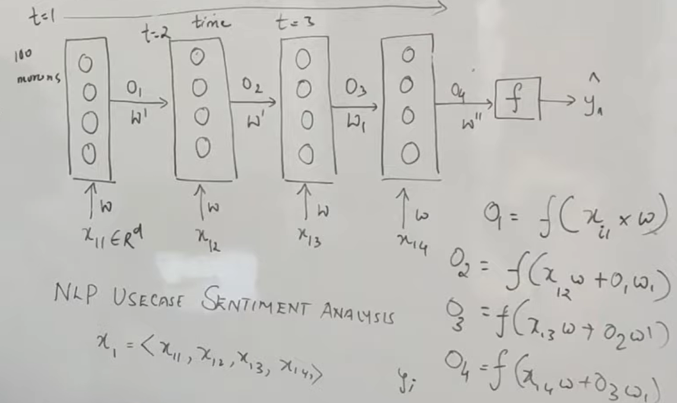
RNN
Sentiment Analysis :
Eg: The food is good – O/p is positive

Slide 9
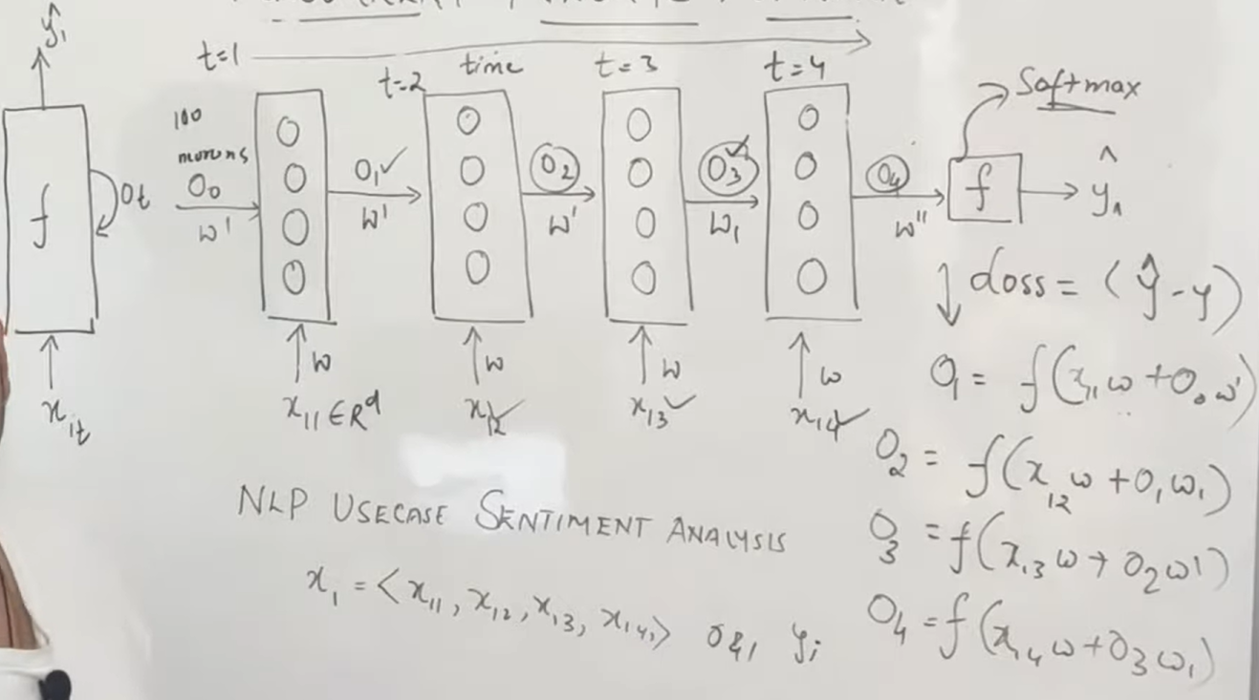
RNN
Sentiment Analysis :
Eg: The food is good – O/p is positive

Slide 10
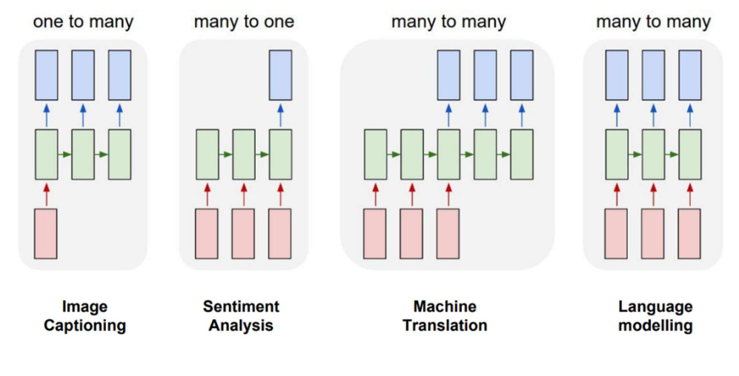
RNN Types

Slide 11
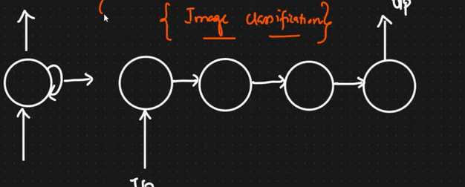
One-to-One

Slide 12
RNN
One-to-One: Image Classification
One-to-Many: Text Generation, Google Search Suggestion, Movie Recommendation
Many-to-One: Sentiment Analysis, Predict next day sale
Many-to-Many: Lang Translation, Question Answering, chatbot

Slide 13
Thank You

